Slide 1
BASIC ELECTRONICS
(24B11EC111)
Unit-1
Lecture-5
(Methods of DC Circuit Analysis Contd.)

Slide 2
CONTENTS
Node Voltage Analysis of Circuits with Dependent Sources
Mesh Current Analysis of Circuits with Independent Voltage Sources
Mesh Current Analysis with Current and Voltage Sources
Problem
References

Slide 3
Node Voltage Analysis of Circuits with Dependent Sources
When a circuit contains a dependent source the controlling current or voltage of that dependent source must be expressed as a function of the node voltages.
It is then a simple matter to express the controlled current or voltage as a function of the node voltages.

Slide 4
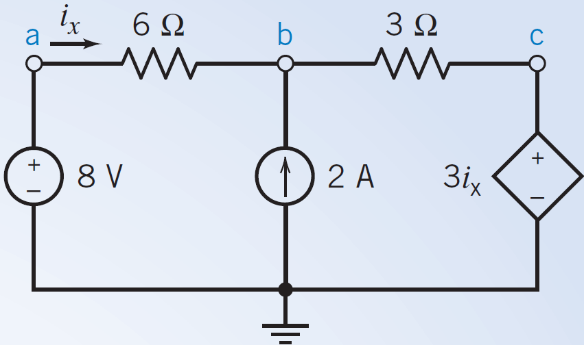
Problem
Determine the node voltages for the circuit shown in Figure
FIGURE - A circuit with a CCVS.

Slide 5
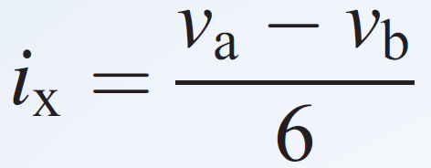
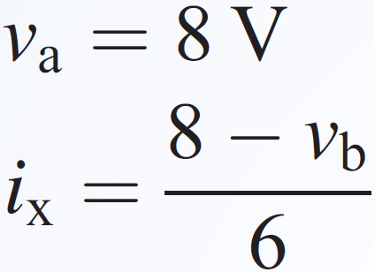
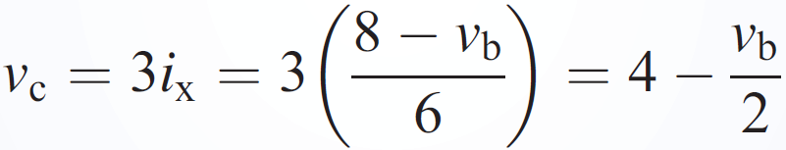
Problem - Solution
The controlling current of the dependent source is i_{x}.
The value of the node voltage at node a is set by the 8-V voltage source
The node voltage at node c is equal to the voltage of the dependent source, so

Slide 6
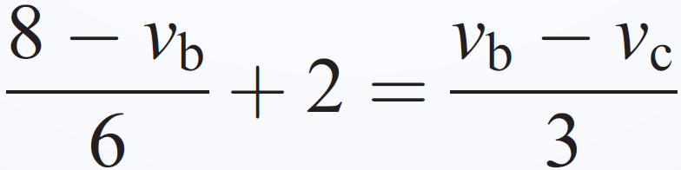
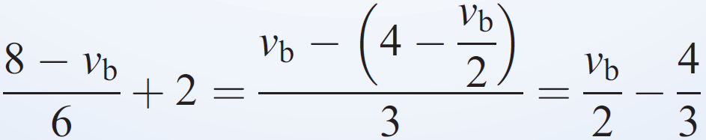

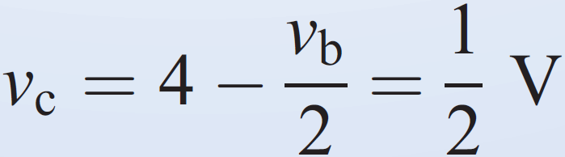
Problem - Solution
Next, apply KCL at node b to get
eliminate v_{c}
Solving for v_{b} gives
Then

Slide 7
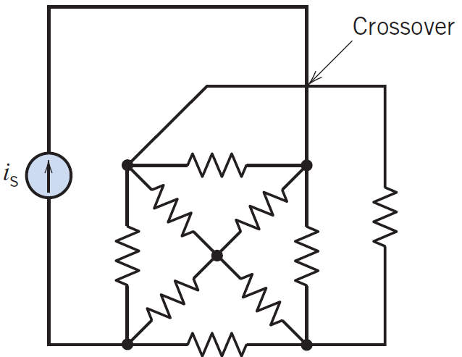
Mesh Current Analysis of Circuits with Independent Voltage Sources
we consider the analysis of circuits using Kirchhoff’s voltage law (KVL) around a closed path
A mesh is a special case of a loop.
A mesh is a loop that does not contain any other loops within it.
Mesh current analysis is applicable only to planar networks.
A planar circuit is one that can be drawn on a plane, without crossovers.
An example of a nonplanar circuit is shown in Figure, in which the crossover is identified and cannot be removed by redrawing the circuit.

Slide 8
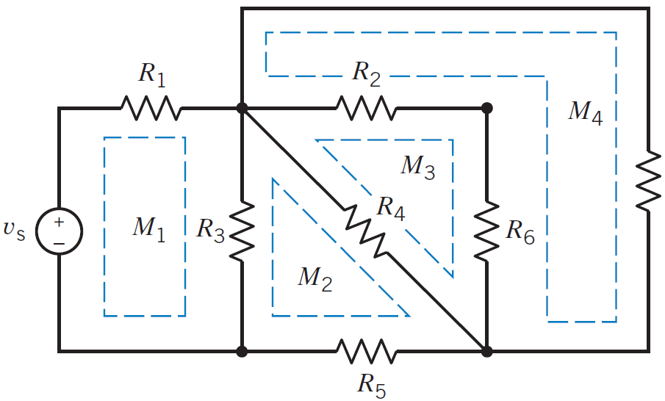
Mesh Current Analysis of Circuits with Independent Voltage Sources
There are four meshes in the circuit shown in Figure.

Slide 9
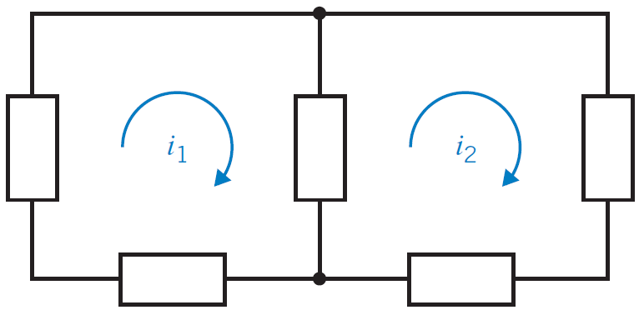
Mesh Current Analysis of Circuits with Independent Voltage Sources
Mesh current as the current through the elements constituting the mesh.
Figure shows a circuit having two meshes with the mesh currents labeled as i₁ and i₂.
We will use the convention of a mesh current in the clockwise direction as shown in Figure.
For analyzing an electric circuit : write and solve a set of simultaneous equations called the mesh equations.
The unknown variables in the mesh equations are the mesh currents of the circuit.
We determine the values of the mesh currents by solving the mesh equations.
To write a set of mesh equations, we do two things:
  Express element voltages as functions of the mesh currents.
  Apply Kirchhoff’s voltage law (KVL) to each of the meshes of the circuit.

Slide 10
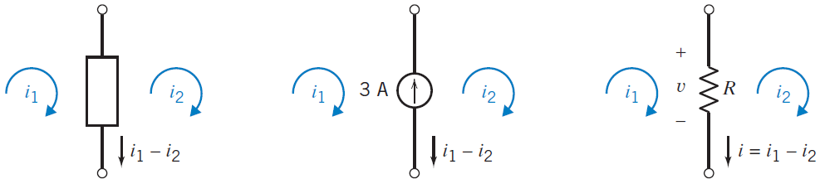
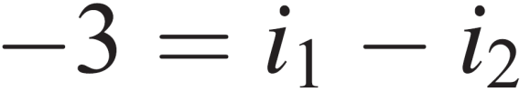
Mesh Current Analysis of Circuits with Independent Voltage Sources
Figure shows a circuit element that is in two meshes.
The reference directions for 3 A and i1 i2 are different (one points up, the other points down)

Slide 11
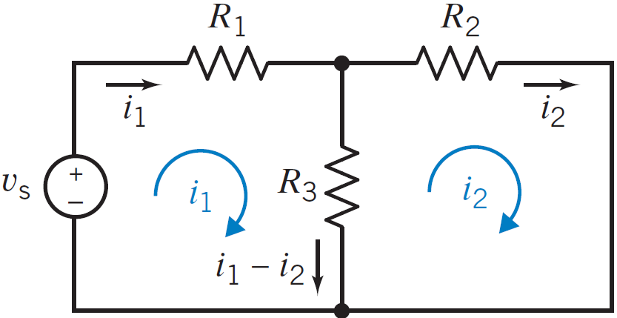
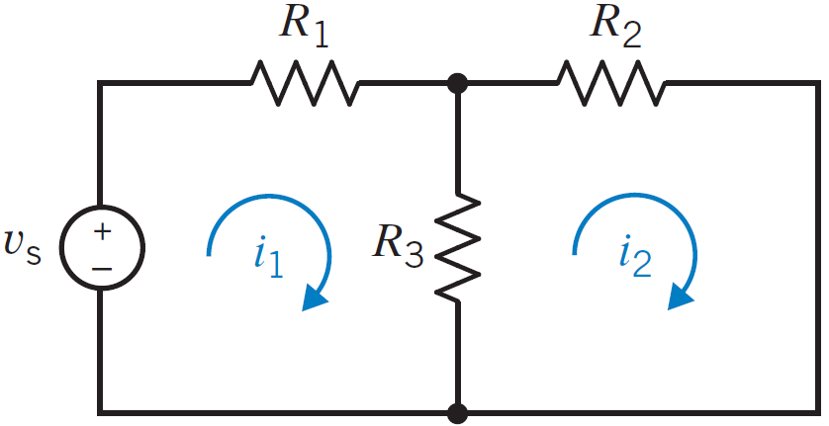
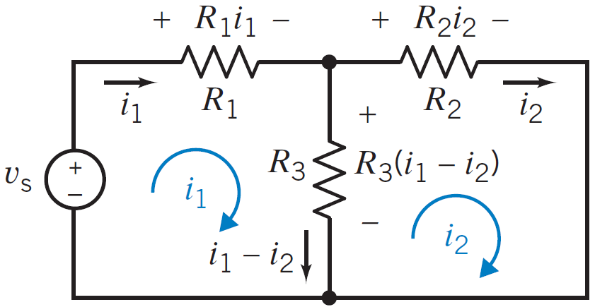
Mesh Current Analysis of Circuits with Independent Voltage Sources
The resistor currents are expressed as functions of the mesh currents, and then the resistor voltages are expressed as functions of the mesh currents

Slide 12
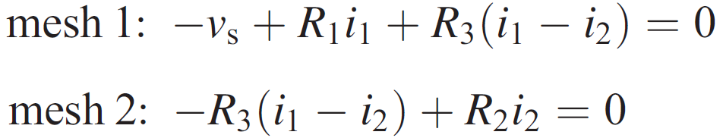
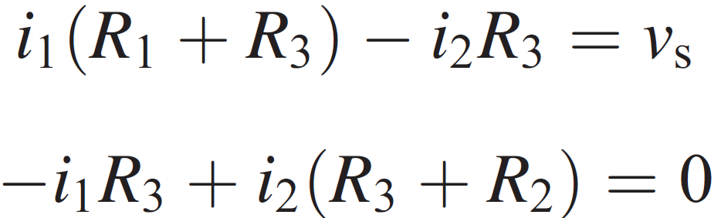
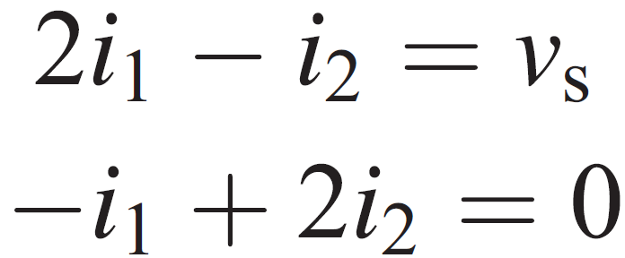
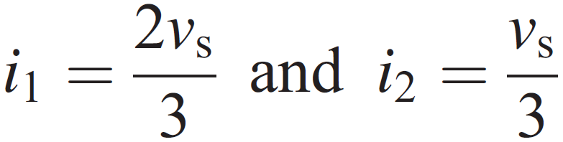
Mesh Current Analysis of Circuits with Independent Voltage Sources
Rewriting the two equations, we have

Slide 13
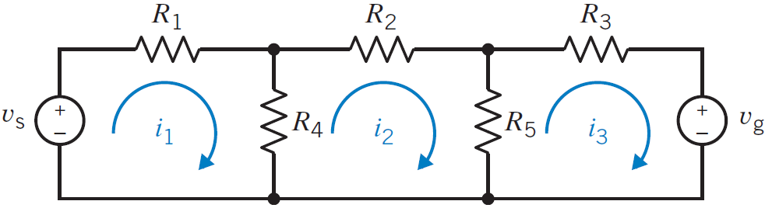
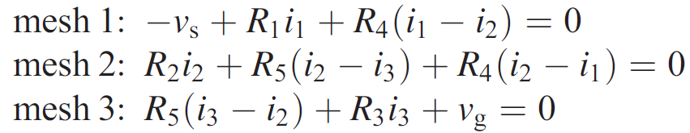
Mesh Current Analysis of Circuits with Independent Voltage Sources
Consider a circuit with three meshes, as shown in Figure.
Assign the clockwise direction to all of the mesh currents. Using KVL, we obtain the three mesh equations
These three mesh equations can be rewritten by collecting coefficients for each mesh current as

Slide 14
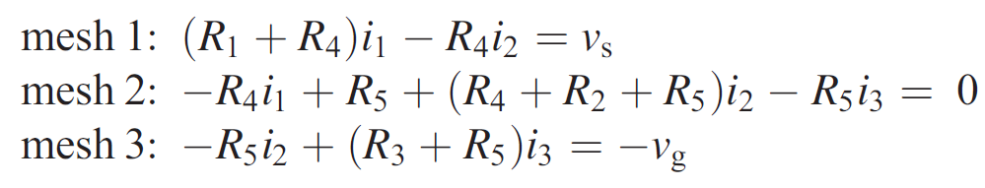
Mesh Current Analysis of Circuits with Independent Voltage Sources

Slide 15
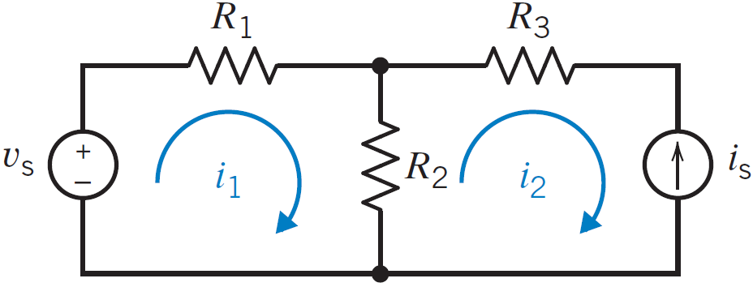
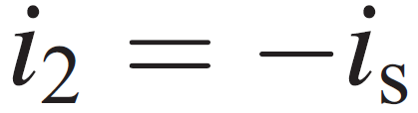
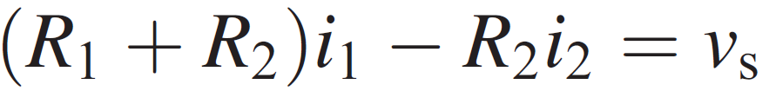
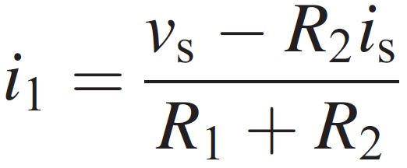

Mesh Current Analysis with Current and Voltage Sources
second mesh current is equal to the negative of the current source current.
and we need only determine the first mesh current i1. Writing KVL for the first mesh, we obtain

Slide 16
References
R.C. Dorf and James A. Svoboda, “Introduction to Electric Circuits”, 9th ed, John Wiley & Sons, 2013.
D.C. Kulshreshtha, Basic Electrical Engineering, Revised 1st ed, Tata Mc Graw Hill, 2017.
V. K.Mehta, Rohit Mehta, Basic Electrical Engineering, 6th ed, S. Chand Publishing, 2012.

